Slide 1
Multi-Agent System for Adaptive Production Scheduling: Develop a multi-agent system where individual agents represent different machines and production lines. They use generative AI to dynamically adjust production schedules in response to unforeseen events (e.g., machine breakdown, rush orders) and RAG to access real-time factory data
Group 24
Vaishnavi Poti -78
Shweta Sidhwani - 103
Ashmit Srivastava -108
Dhruv Tater - 113

Slide 2
Production Scheduling
Production scheduling is a process that determines the sequence and timing of manufacturing tasks to optimize resource allocation, meet production goals, and ensure timely delivery of products. It involves planning and organizing production activities to efficiently utilize resources like machinery, labor, and materials, while also considering factors like lead times, priorities, and potential bottlenecks.

Slide 3
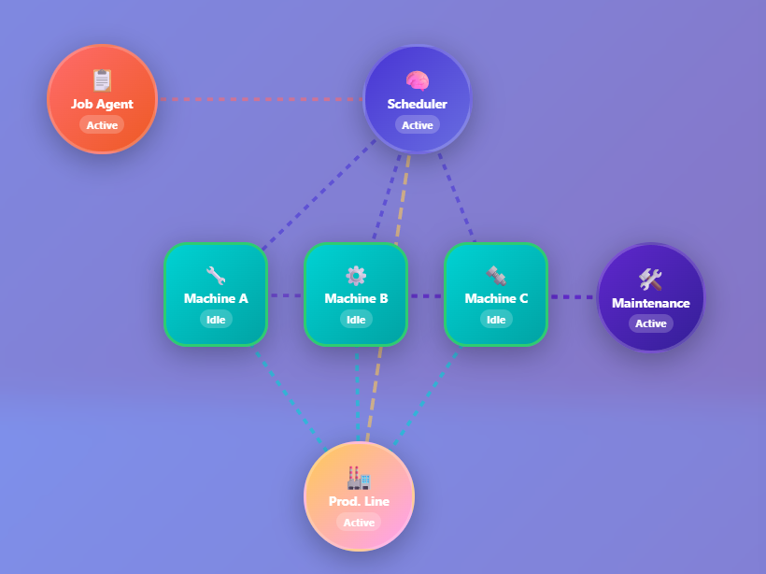
Multi- agent System Workflow

Slide 4



Methodologies Used
1. CrewAI 2.Vanilla Python 3. Langchain

Slide 5
Agent
An agent is a software program designed to perceive its environment, reason, and take actions to achieve specific goals. These agents can range from simple automated systems to complex, autonomous entities that interact with the world and learn from their experiences. They are a core component in building intelligent systems capable of performing tasks, making decisions, and solving problems.
RAG
Retrieval-Augmented Generation, is an AI framework that combines the strengths of large language models (LLMs) with external knowledge sources. It enhances the capabilities of LLMs by allowing them to access and incorporate information from outside their training data, leading to more accurate, up-to-date, and relevant responses.
Gen AI
AI systems that can create new content like text, images, music, and videos. It's a subfield of AI focused on producing novel, original outputs based on patterns learned from existing data. GenAI models, often large language models (LLMs), can be trained on vast datasets and then used to generate new, realistic content in various formats.

Slide 6
Thank You

